Slide 1




Team White – All the Buzz
Blayten • Spencer • Kassidy . Christy • Ju-Ju

Slide 2




Project Overview
Problem:
Buzzword Software is a rapidly growing company, and the marketing team wants to improve company branding and visibility
Solution:
Create a dynamic data feed, All The Buzz™, that delivers computer themed jokes, trivia, quotes, and biographies. This can be used to enhance the company's brand visibility by enriching digital experiences across internal and external platforms.
Ex: Computer trivia line to the footer of internal websites
Adding quotes or bios to outgoing newsletters
Creating a computer joke contest for marketing expos

Slide 3
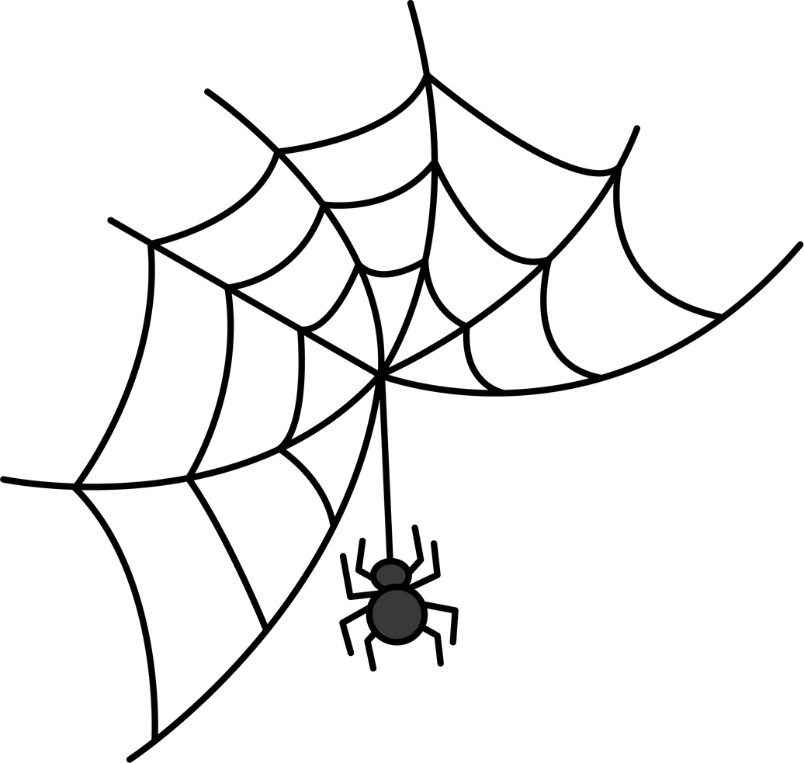








Technical Overview
Python
Pytest
Python Logger
Sphinx Documentation
MongoDB
VSCode
Postman
Flask

Slide 4

Methodology:
Prioritized setting up some of the most critical features of our software:
Database operations
Handling data
Sanitization
Validation
Business logic
Documentation
Logging
Testing

Slide 5



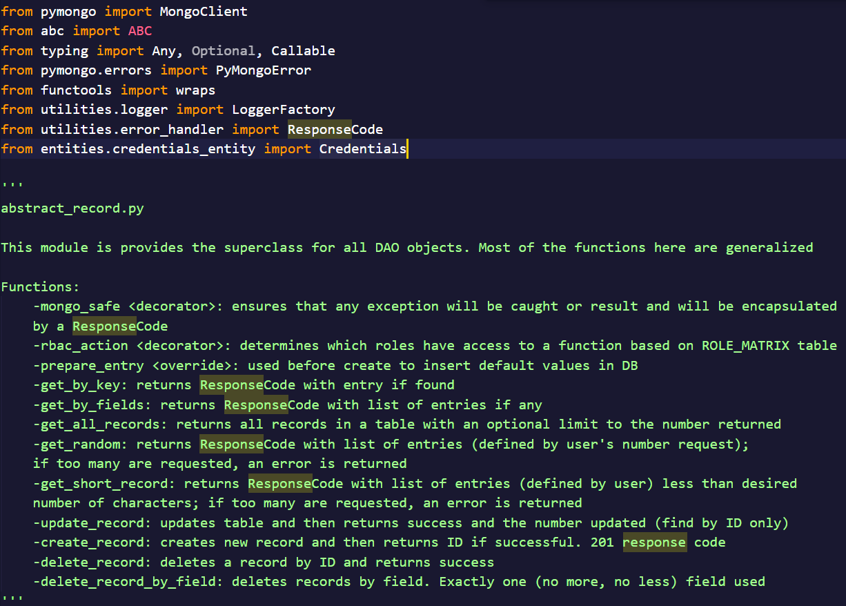
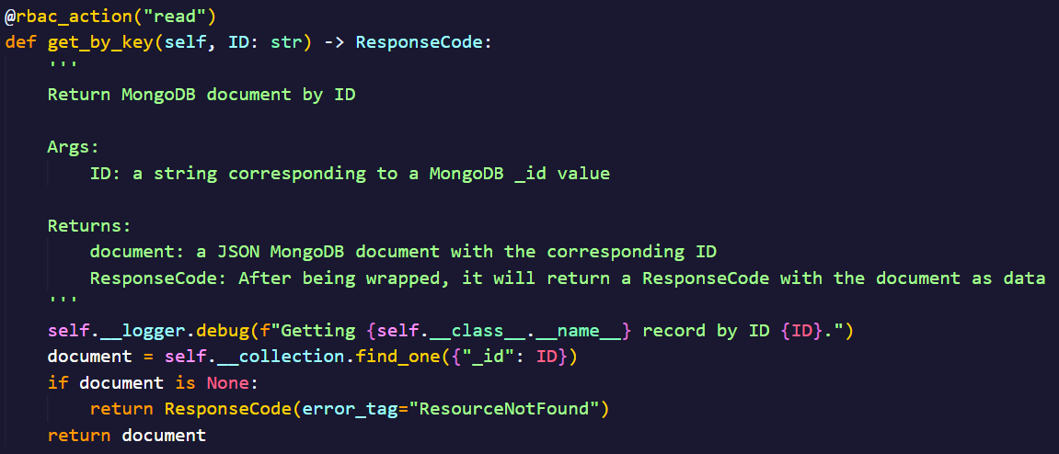


DB Code
Documentation

Slide 6
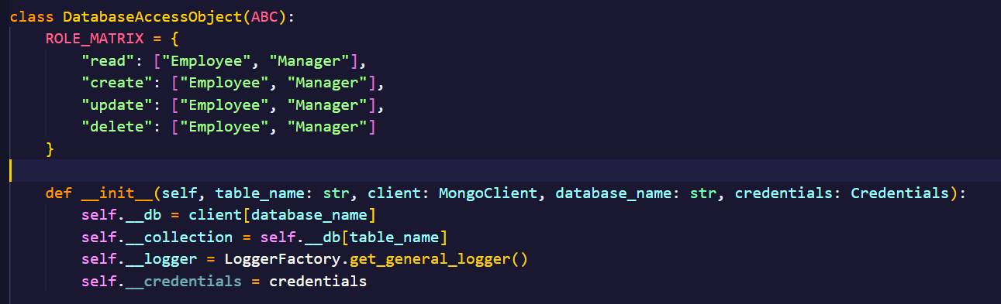
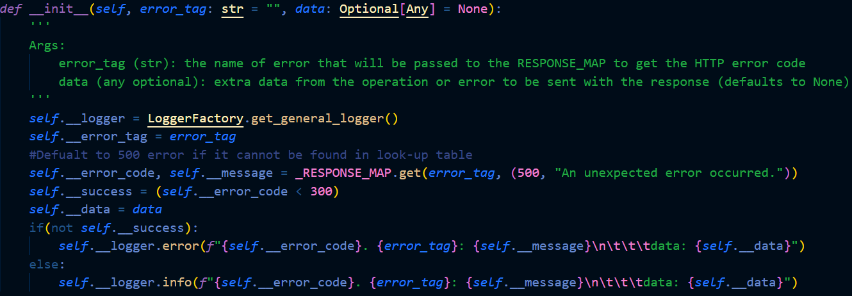
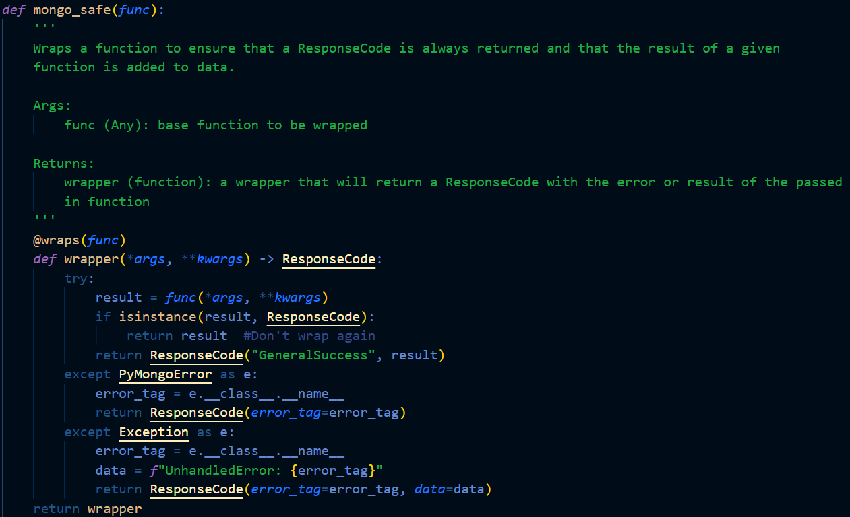
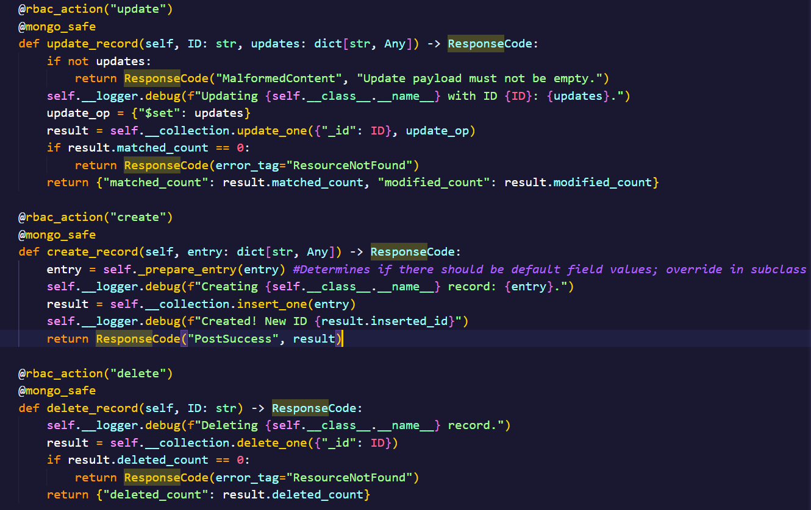

DB Code
Logging

Slide 7

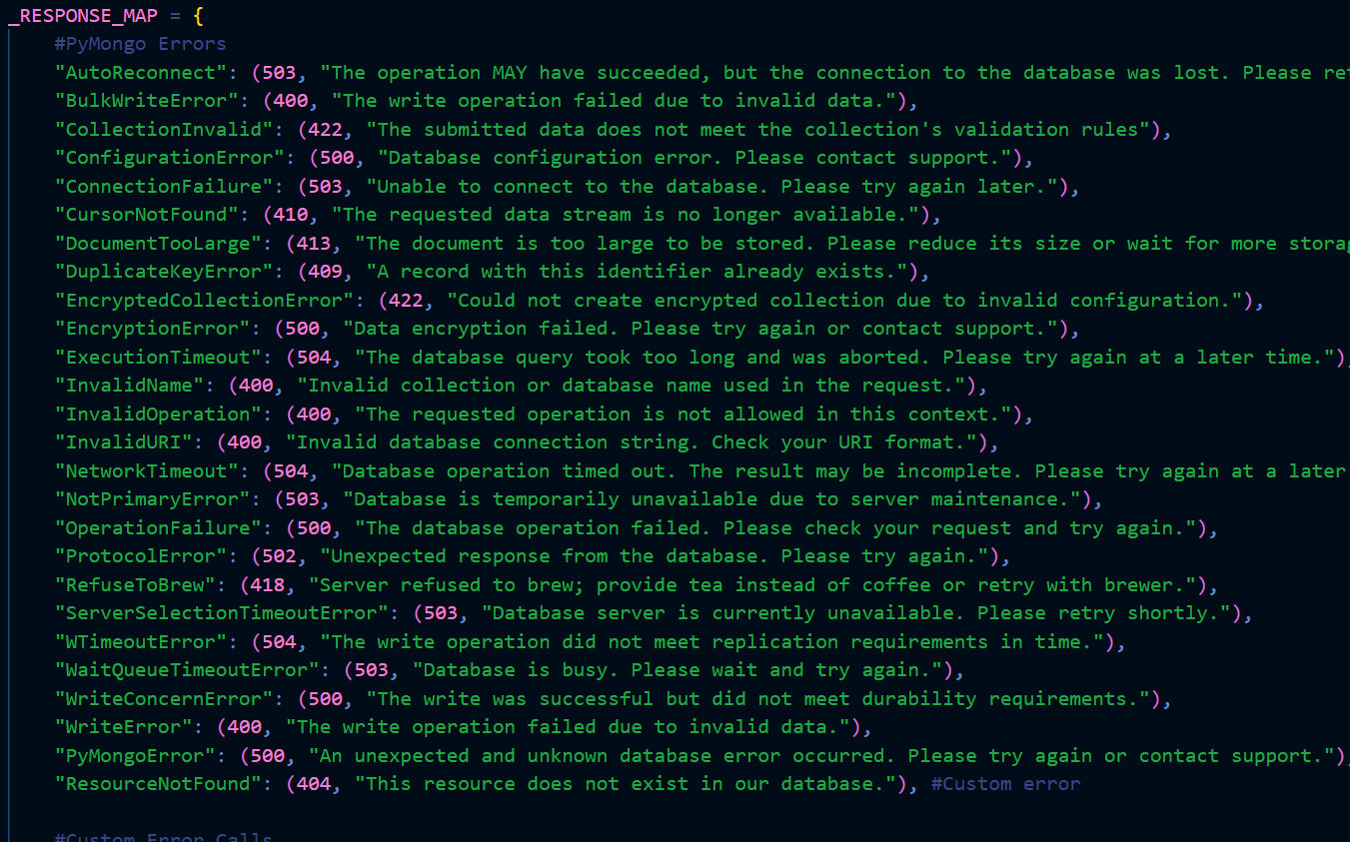


Slide 8


DB Code
Logic

Slide 9

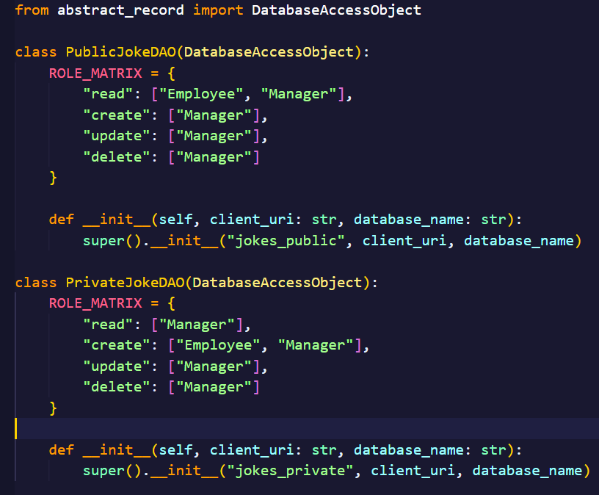

DB Code
Extended Logic

Slide 10
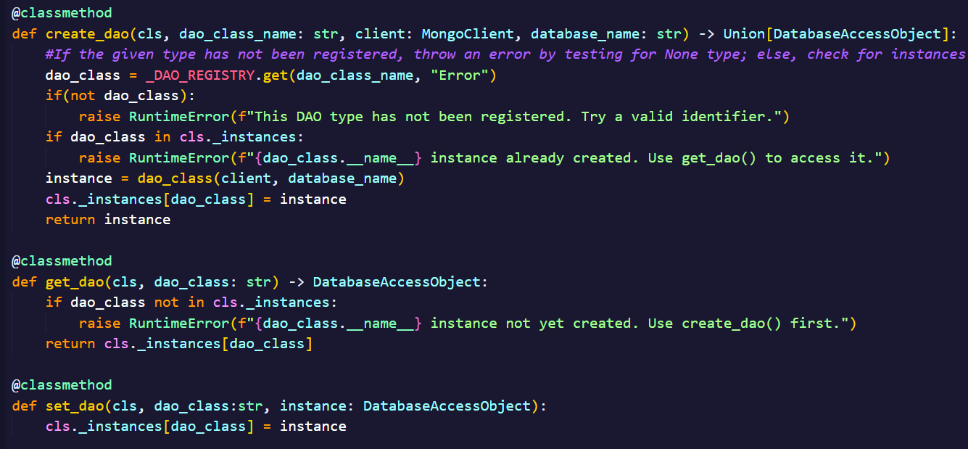

DB Code
Initialization

Slide 11
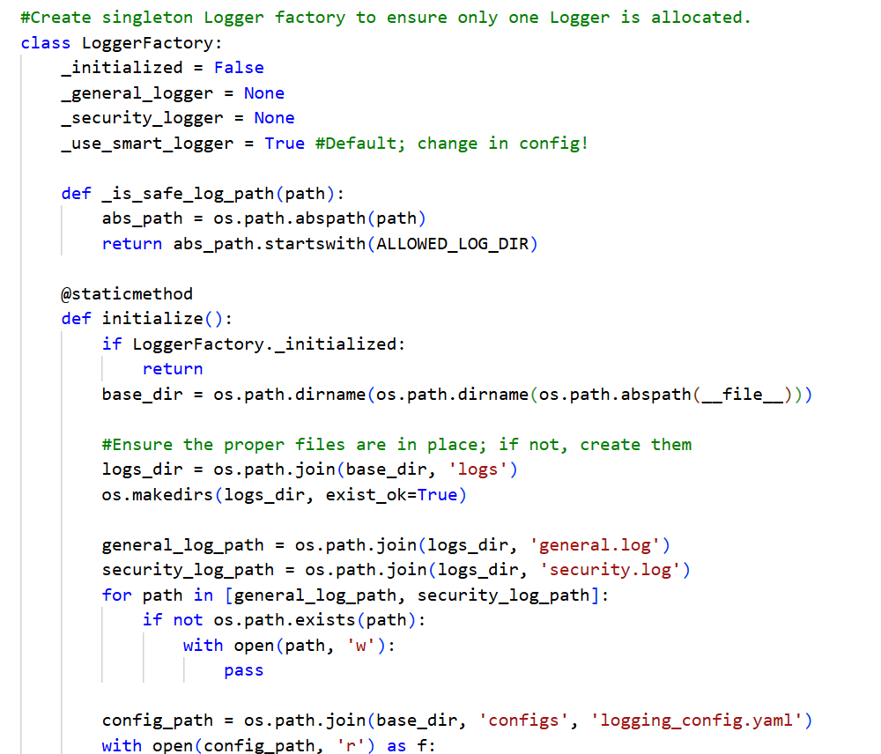
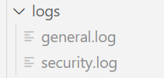


Logging

Slide 12

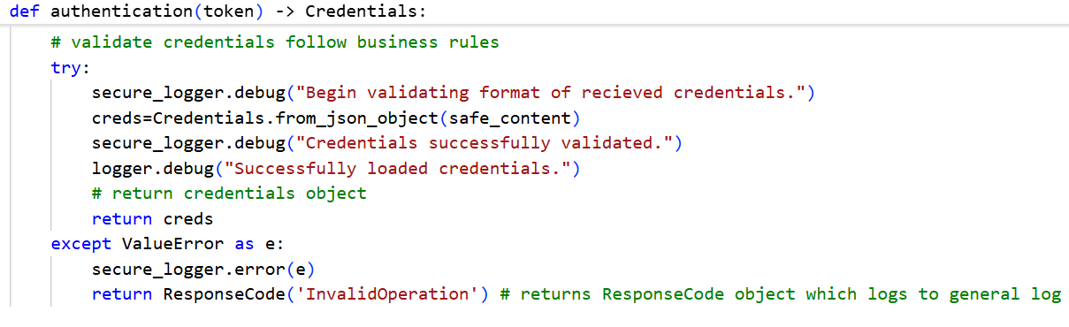

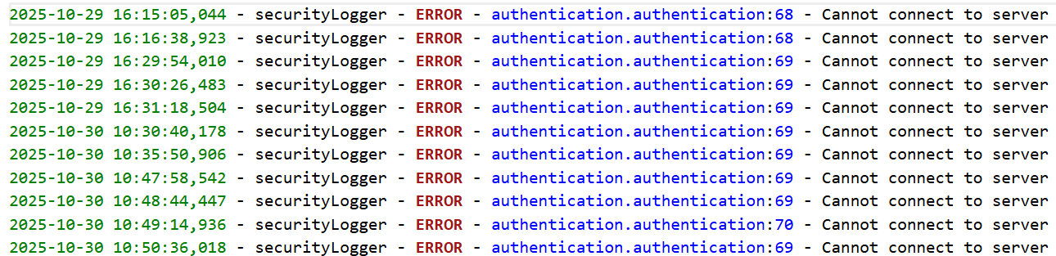
Logging

Slide 13

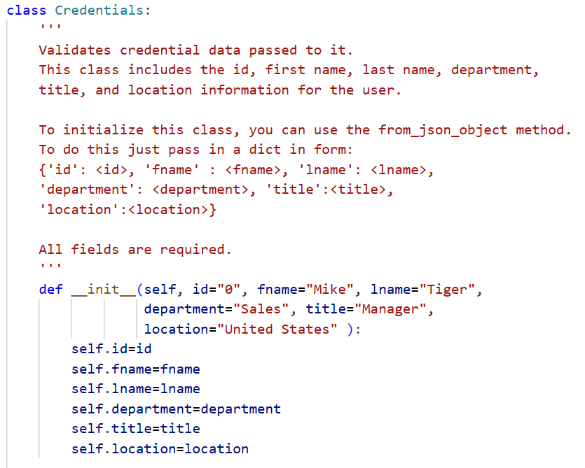
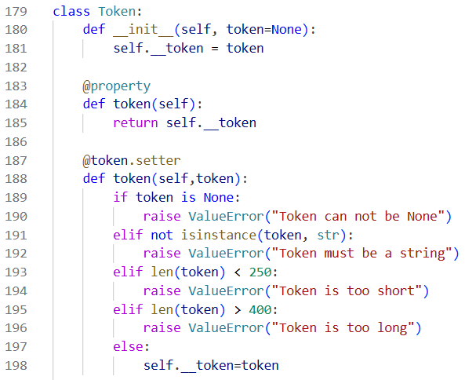
Unit Testing
credential_entity.py
NAME SURNAME

Slide 14

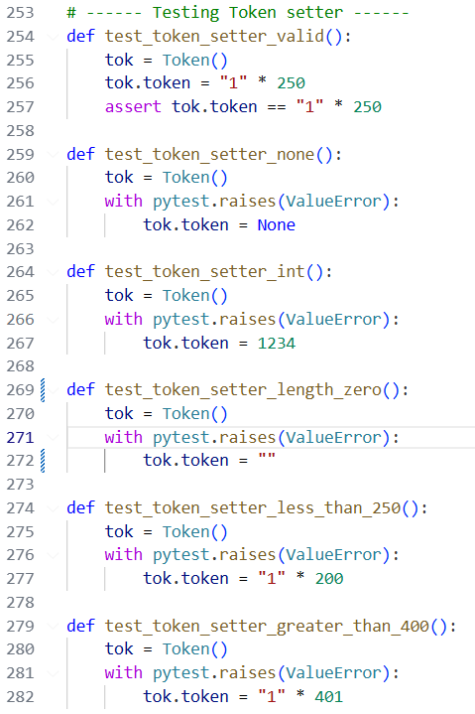
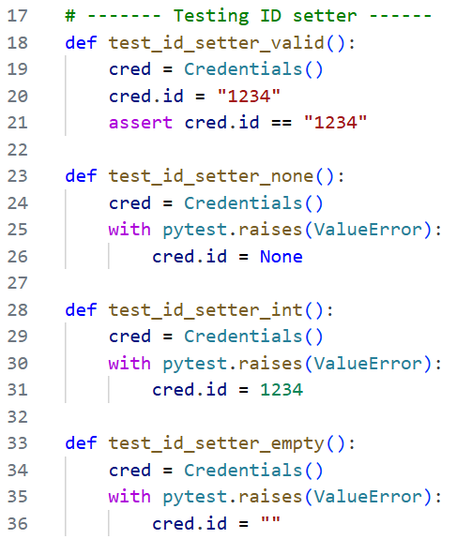


Test setups
z
test_credentials.py

Slide 15
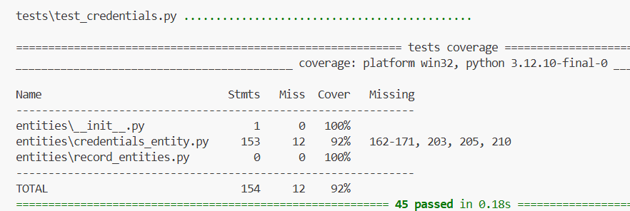
Result of Unit Tests

Slide 16
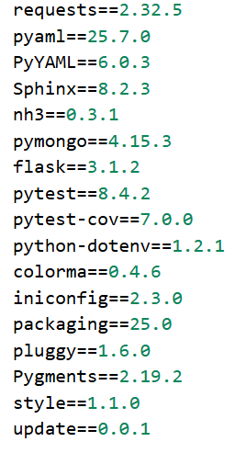
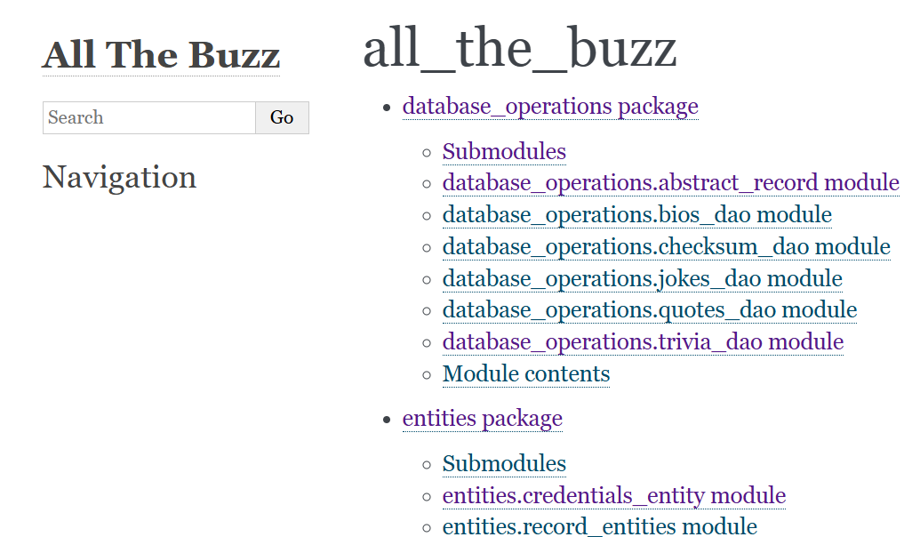

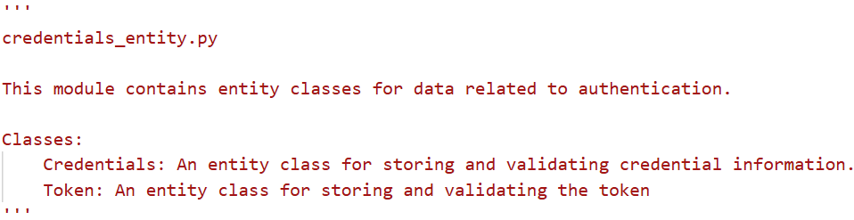
Documentation

Slide 17




Thank you!
Any questions?

